Slide 1
Design and Verification of Cache AND ITS coherency USING DRAGON PROTOCOL IN SySTEM VERILOG
By
Sai Krishna Ravauri
Subrat Mahalik
Dhanush T
Lokesh Astakar

Slide 2
Project Proposal & Design Details
To Design and verify a single level cache maintaining cache coherency.
Dragon protocol is used to ensure cache coherency.
LRU replacement policy used for eviction.
Simulation environment : System Verilog(Questa Sim), Mentor Veloce.

Slide 3
ASSUMPTIONS
All memory operations takes single clock cycle.
No turnaround time considered for DataBus.

Slide 4
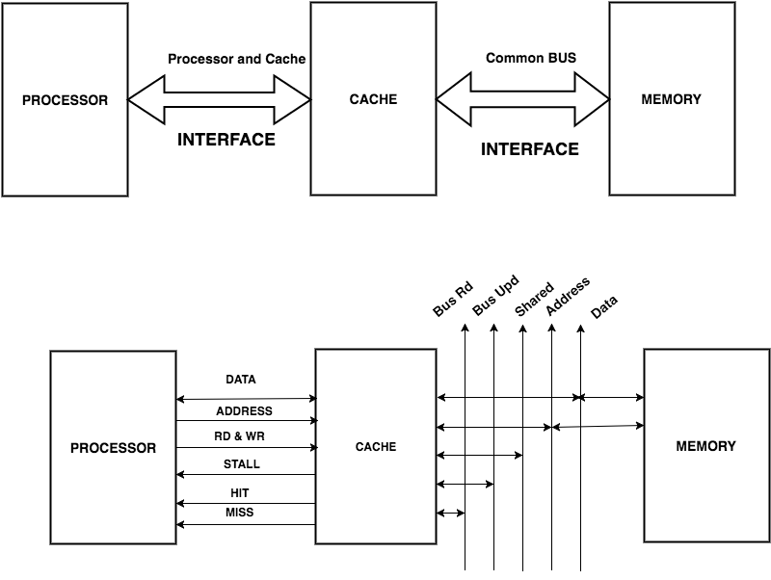
Top Level Design

Slide 5
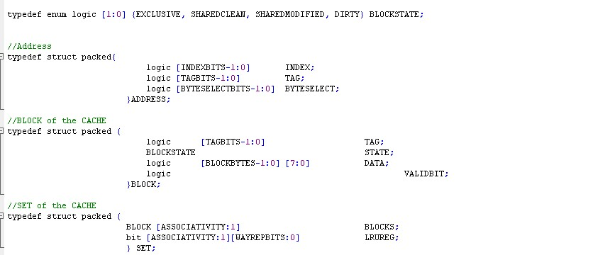
System Verilog Constructs used
Design
Interfaces
typedef
enumarated types
always_ff
structures
Packages
Randomize()
Class
Assertions

Slide 6
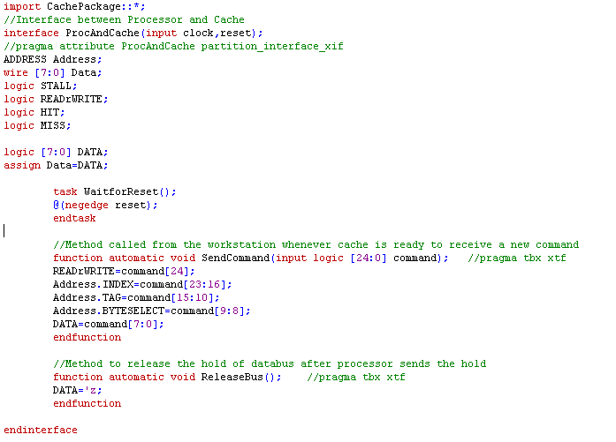
Interfaces

Slide 7
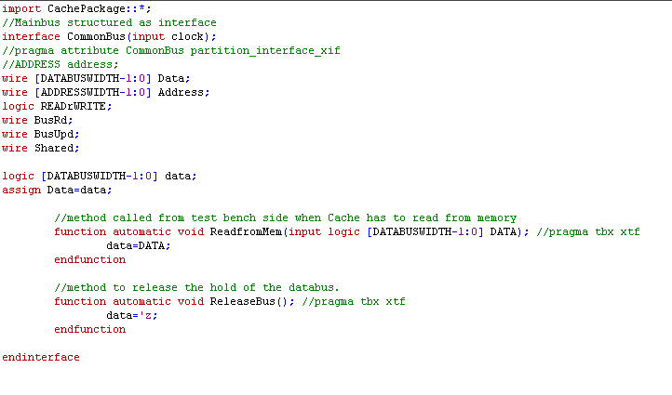
Interfaces cont….

Slide 8
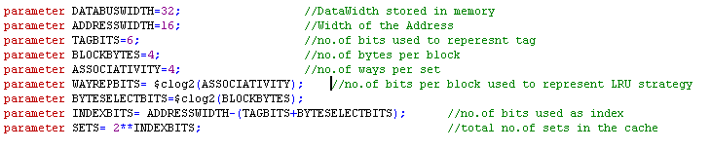
Design Details
Proc_cache | Common bus (between Data memory and cache)
Read/Write | Address 2bytes
Address 16 bits | Data 8 bytes
Data 1byte | Bus Read, Bus update
Hit/Miss | Shared
Stall | Read,Write
Cache:
Processor:-
Issues 40 bit instructions(Read/Write, Address, Data)
First 41 instructions are deterministic and the rest are randomly generated.
Checks at every negedge of the clock for the deasserted stall signal and issues instructions.
Interfaces

Slide 9
Design Details conti…
Cache
4 way set associative cache.
Cache size is 4 KB and 256 cache sets.
4 blocks in each way of the set.
Cache Block contains Tag (6 bits) , LRU bit(3bits) , State, Data.
Memory
Memory size is 256KB
Randomly generated the Data and stored it in a memory image.
readmemh() & writememh() functions are used to fetch and write the data from/to the memory image respectively.

Slide 10
Eviction Strategy
True LRU eviction technique was adapted to evict the block from cache.
An array is used for each set which contains the lines in the most recently to least recently used order from left to right.
Consider the status of LRU array of a set is as follows
3 1 2 4
If 2rd way is accessed by the processor then the LRU is updated as
2 3 1 4

Slide 11
Coherency
Dragon Protocol was adapted to maintain the coherency of the cache.
It was originally developed by XEROX PARC used in Xerox Dragon Multiprocessor WorkStation.
This protocol employs the write back policy, i.e; the during eviction of the line the memory is updated
It is also called as update protocol, because whenever a cache line in shared state is updated by a cache, the an Bus Upd signal broadcasted on to the common bus indicating the other processors to update their lines, if they have any.
When any processor is reading from memory it broadcasts BusRd signal and the other caches on seeing the BusRd signal asserts the Shared signal indicating that they have too have a copy of it.

Slide 12
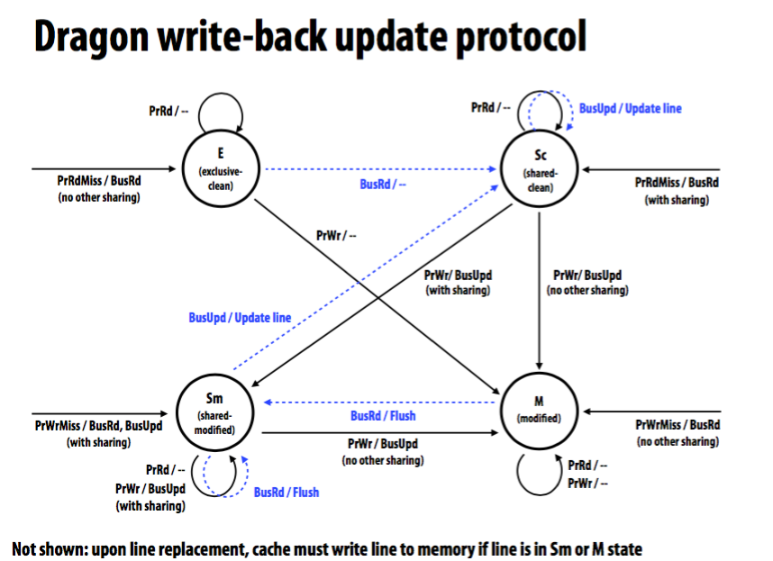
Dragon update protocol
Source: CMU

Slide 13
Controller

Slide 14
Verification Plan
Bottom Up Approach is followed.
Individually verified LRU Mechanism, Protocol and Top Level Module.
Checkers are used to validate input command and state transition of the cache block , LRU Register.
Scoreboard to keep track of number of cache hits and misses.
Functional coverage to check all the design specification are met.

Slide 15
Verification
Constructs Used:
Assertions
Randomization ( $urandom_range() )
Classes
$display
`ifdef & `endif macros

Slide 16
Verification of LRU Mechanism
We have tested the working of LRU mechanism using deterministic and the random cases.
We have used immediate assertions to check it working

Slide 17
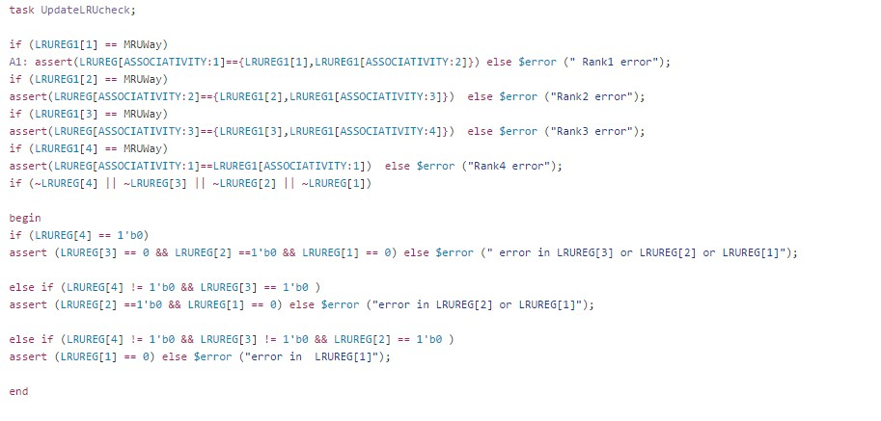
One important case is that, whenever an entry in the LRU register is 0, then the entries to the left of it must all be zeros. No serious bugs found while verifying this

Slide 18
Verification of Protocol
Similar approach as LRU is followed here too.
First we have given the inputs to check whether all the state are transitioned as expected and then randomized the things and checked using immediate assertions.

Slide 19
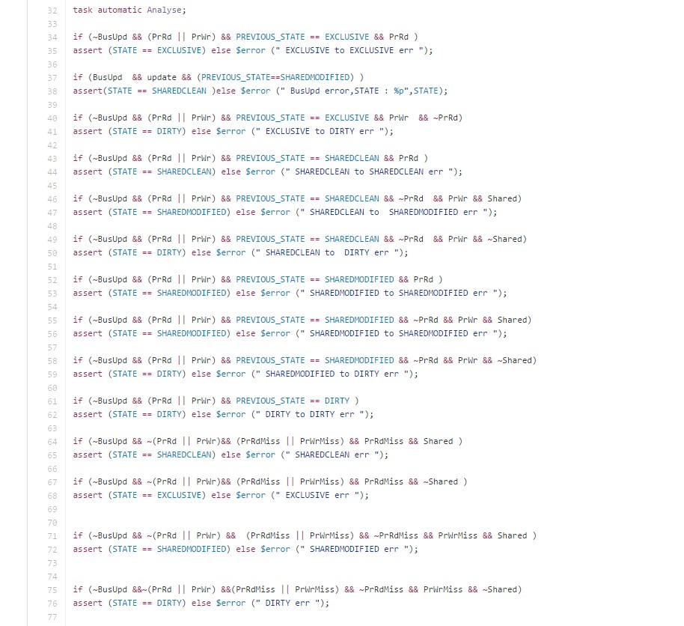

Slide 20
Bugs found:
State was not changing from Shared Modified to Shared Clean when BusUpd signal was snooped by the controller.
Status: Resolved.

Slide 21
TopLevel

Slide 22


Checker(Assertions)
Property 1 and 2:
On any rising edge of clock if the STALL signal is disserted and a valid READrWRITE command is asserted, then a valid address must be available on the Address bus between processor and cache on the same clock edge .
If the request is Write then Valid data must also be available the same edge.

Slide 23


Property3:
Whenever a MISS signal is asserted on any positive edge of clock and the request is READ, valid data must be send to the processor on the third clock tick and the stall signal must be deasserted within the next clock tick.
Property4:
If the Request is WRITE, STALL must be deasserted on the fourth clock tick.

Slide 24

Property 5:
At any clock edge , if HIT signal is asserted because of READ request, valid data must be send to the processor on the next clock tick, and STALL must be deasserted by the next clock.
Property 6:
If the request is WRITE, STALL must be deasserted within 2 clock cycles.

Slide 25

Property 7:
On any negative of clock if BusUpd or BusRd signal is asserted valid Data and Address must be available on the CommonBus.

Slide 26
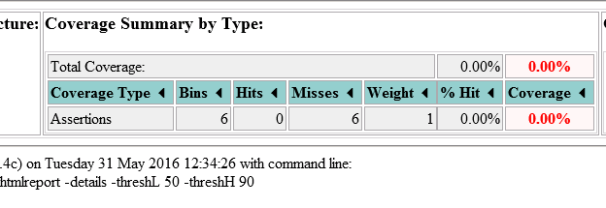
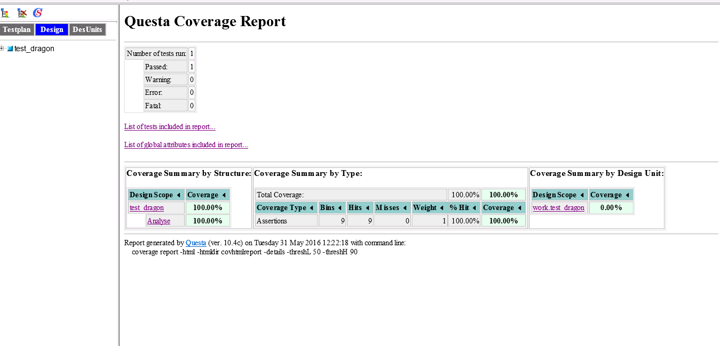
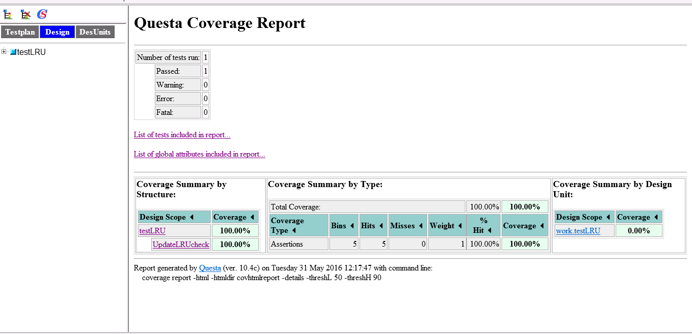
Coverage Reports

Slide 27
Bugs found!!
TYPE | Status
Protocol and LRU were updating twice | Resolved
While controller is sending update(BusUpd) signal, it should place valid data & valid address on the common bus for the other caches to update the cache block | Unresolved
Controller was updating the state of its own cache line while it is intending sending the bus update signal. | Resolved
Cache is not sending the valid data to the processor during read operation | Resolved

Slide 28
Debugging
Immediate Assertions were used in the middle if the code when required.
And Display statements were embedded to follow the flow of execution.
Sometimes waveforms were more useful than display statements.
All the code used for debugging was made conditionally compliable using ifdef and endif macros.

Slide 29
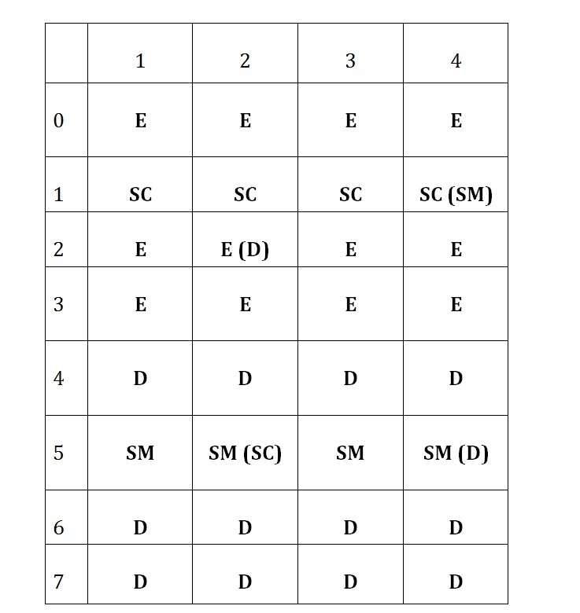
Test Cases
Deterministic:
First verified with 41 deterministic test cases and then moved to random stimulus.
Since deterministic we figured out the states of all lines that were used till 41 cases. Then we verified our predetermined states to the actual states of the lines and found exactly matching.
We have used 0-7 sets for deterministic cases and the expected states must be as shown in the figure.
For random cases, we have verified with 100, 10,000, 1,000,000 cases.

Slide 30
ScoreBoard (a Class)

Slide 34
Cache controller(small changes in pic..use Reset in)

Slide 35
Dragon block

Slide 36
Assertions
Immediate and Concurrent Assertions are used.
Immediate Assertions are used to check the State transitions of the protocol and LRU register .

Slide 37
Assertions conti…
Concurrent Assertions are used to check
valid Data after asserting read or write signal
valid Address after asserting read or write signal.
valid Data after 3 clock cycles of read or write miss.
Valid Data after one clock cycle of write miss

Slide 38
Simulation statistics

Slide 39
Functional Coverage

Slide 40
Emulation on Veloce
Standalone
Log
Errors
resolved
TBX-BFM
Initial errors
Design compilation report

Slide 41
Results and Future work

Slide 42
References
http://www.cs.cmu.edu/afs/cs/academic/class/15418-s12/www/lectures/11_coherence2.pdf
Sameer’s Slides on Mentor Veloce Emulator.

Slide 43
Thank you…..

